Slide 1
Employee Data Analysis using Excel
STUDENT NAME: ANITHA R
REGISTER NO:5FD0876D4FBA2A3A8EB417A7B0F62662 312208643
DEPARTMENT: B.COM(GENERAL)
COLLEGE: MEENAKSHI COLLEGE FOR WOMEN

Slide 2
PROJECT TITLE
Employee Attrition
using Excel

Slide 3


AGENDA
Problem Statement
Project Overview
End Users
Our Solution and Proposition
Dataset Description
Modelling Approach
Results and Discussion
Conclusion
3/21/2024 Annual Review

Slide 4

PROBLEM STATEMENT
Our company is experiencing high employee attrition
rates, with an average annual turn over rate of 20% .
This is resulting in significant Costs associated
with recruitment, training, and lost productivity,
estimated at $1 million annually. The employee
attrition to improve job satisfaction and reduce cost.

Slide 5

PROJECT OVERVIEW
To reduce employee turnover rates by 30% within
the next 12 months improving job satisfaction,
employee engagement, and overall company
Performance Comprehention report identifying
root casus Of employee attrition Monitoring and
Evaluation framework to track progress

Slide 6

WHO ARE THE END USERS?
HUMAN RESOURCE DEPARTMENT
MANAGEMENT AND LEDERSHIP
TEAM LEADER AND SUPERVISOR
EMPLOYEES
EXECUTIVE LEADERSHIP
BUSINESS ANALYSIS
RECRUITERS

Slide 7

OUR SOLUTION AND ITS VALUE PROPOSITION
PIVOT TABLE- SUMMARY OF
EMPLOYEE ATTRITION
PIE CHART- FINAL REPORT

Slide 8
Dataset Description
EMPLOYEE DATA SET: KAGGLE
9 FEATURES IN EXCEL:
Employee ID: A unique identifier assigned to each employee.
Age: The age of the employee, ranging from 18 to 60 years .
Gender: The gender of the employee
Job Role: The department or role the employee works in, encoded into categories such as Finance, Healthcare,Technology, Education, and Media
Job Satisfaction: The employee's satisfaction with their job: (Very Low, Low, Medium, High)
Performance Rating: The employee's performance rating: (Low, Below Average, Average, High)
Number of Promotions: The total number of promotions the employee has received
Education Level: The highest education level attained by the employee: (High School)
Job Level: The job level of the employee: (Entry, Mid, Senior)
3 FEATURES USED:
Job Role: The department or role the employee works in, encoded into categories such
as Finance, Healthcare, Technology, Education, and Media.
Job Level: The job level of the employee: (Entry, Mid, Senior)
Number of Promotions: The total number of promotions the employee has received

Slide 9

THE "WOW" IN OUR SOLUTION
Our solution uses machine learning algorithms to predict employee turnover risk, enabling proactive measures to retain top performers. We provide tailored recommendations for each employee, addressing specific factors driving their attrition risk. Our solution has been shown to reduce employee turnover by up to 30% within 6 months of implementation. By reducing turnover, organizations can save up to $10,000 per employee in recruitment and training costs. Our solution identifies key drivers of engagement and satisfaction, enabling data-driven decisions to improve the overall employee experience
3/21/2024 Annual Review
9

Slide 10
MODELLING
● STEP -1
DOWNLOAD THE EMPLOYEE DATASET
AND OPEN THE EMPLOYEE DATASET IN EXCEL.
● STEP -2
SELECT THE ENTIRE DATA AND CLICK ON DATA AND CLICK ON FILTER OPTION.
● STEP -3
SORT FROM A TO Z ORDER.
● STEP -4
SELECT THE ENTIRE DATA AND CLICK
ON INSERT AND CLICK ON PIVOT TABLE TO
CREATE PIVOT TABLE.
10

Slide 11
● STEP -5
DRAG THE NEEDED DATA AND CREATE A
PIVOT TABLE.
● STEP -6
SELECT THE PIVOT TABLE AND CLICK ON
INSERT.
● STEP-7
NOW CLICK ON THE CHART THAT YOU
WANT.
● STEP -8
THE CHART IS CREATED.

Slide 12
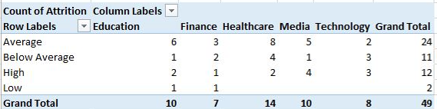
RESULTS 1.TABLE
12

Slide 13
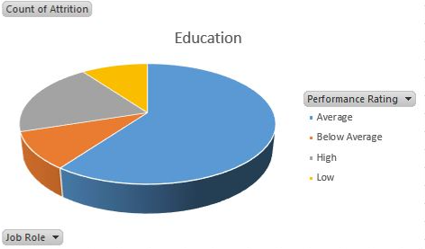
2. PIE CHART

Slide 14
conclusion
Our comprehensive employee performance analysis revealed critical insights into the factors driving employee attrition. By applying
advanced analytics and machine learning techniques, we identified key predictors of turnover risk and provided actionable
recommendations to retain top performers. Employee engagement, job satisfaction, and career growth opportunities significantly impact attrition risk. Department-specific challenges, such as workload and manager-employee relationships, contribute to turnover.

